Slide 2
1. Title page 74…BACTERIA 2. Attach questions to page 74

Slide 3
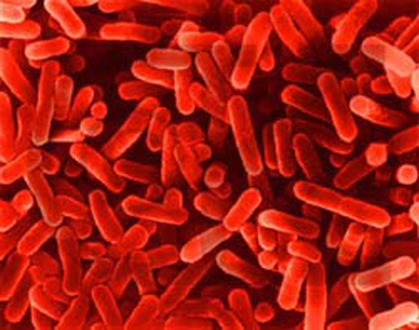
Bacteria
Often use microscopes to look at bacteria
Important characteristics:
Prokaryote
Unicellular
Some good, some bad!

Slide 4
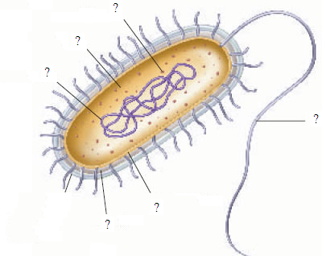
Ribosomes
cytoplasm
All Bacteria have…
DNA
Cell Membrane

Slide 5
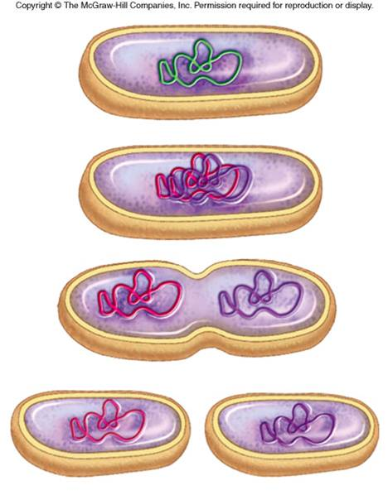
How do bacteria reproduce?
Asexually- the DNA of one organism doubles and splits (MITOSIS)

Slide 6
How are bacteria organized?
Cocci (round)
Bacilli (rod)
Spirilli (spiral)

Slide 7
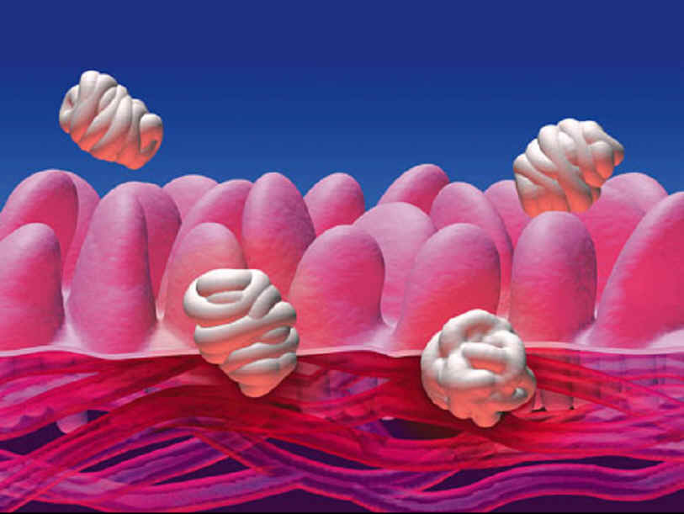
Good Bacteria!
We have many bacteria inside us!
Help us with various functions
Digestion
Immunity (keeps you healthy)
Converts nitrogen to a useable form in the nitrogen cycle
We often accidentally kill the good bacteria with antibiotics and sanitizers

Slide 8
Antibiotics and Sanitation
We kill bacteria with antibiotics
Penicillin
Amoxicillin
Also can use sanitizers to kill surface bacteria
However, bacteria can become resistant!
How?
MUTATIONS!! Because bacteria reproduce so quickly- more chance for mutations(changes)

Slide 9
Bad Bacteria
Many common ones you hear about
E. coli (food poisoning)
Streptococcus (strep throat)
Syphilis (STD)
Staphylococcus (staph infections)

Slide 10
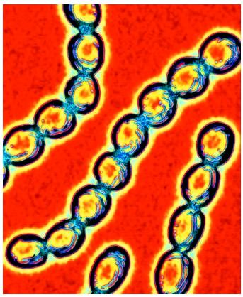
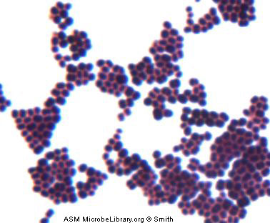
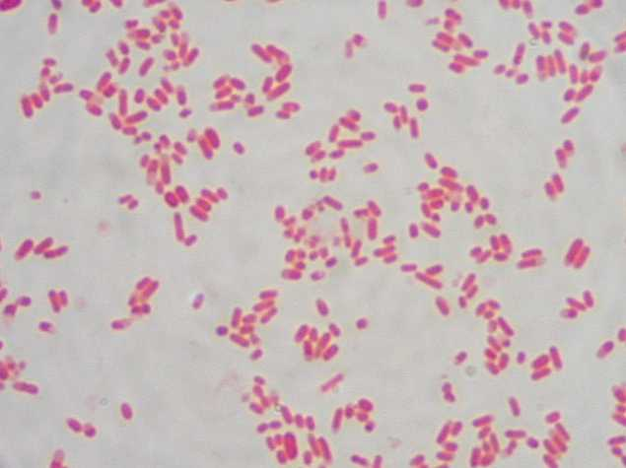
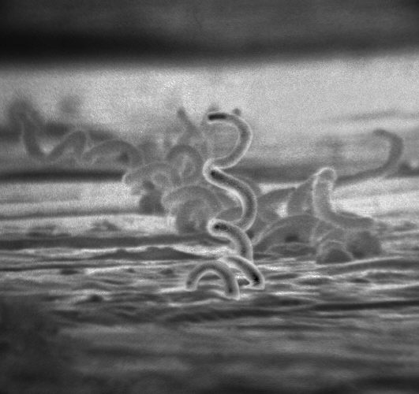
(
Streptococcus (Strep Throat)
Staphylococcus (Staph Infection)
Bacillus (E. Coli)
Spirochete (Syphilis)

Slide 11
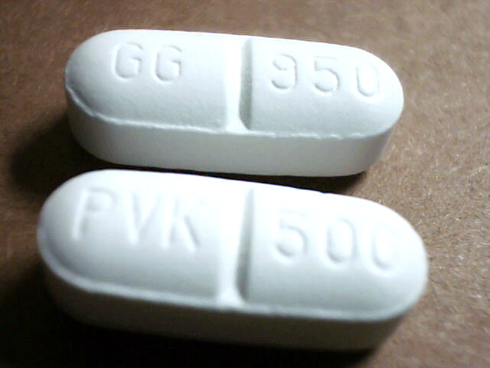
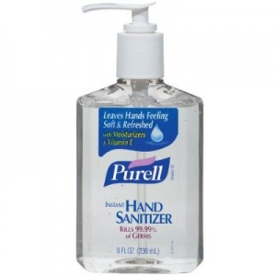
Good in moderation
Antibiotics
Hand Sanitizer

Slide 12
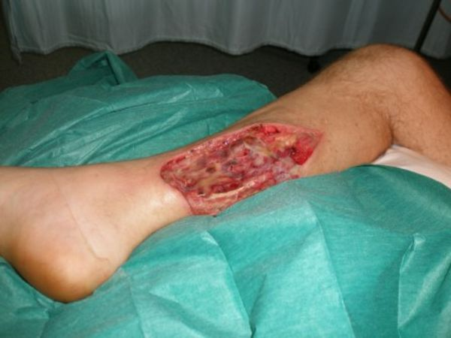
Flesh-eating Bacteria (MRSA)

