Slide 1
Biotechnology

Slide 2
Biotechnology…82
Flip to the back of page 82 and add the pink questions to the left side of the page.

Slide 3
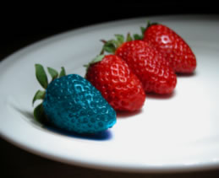
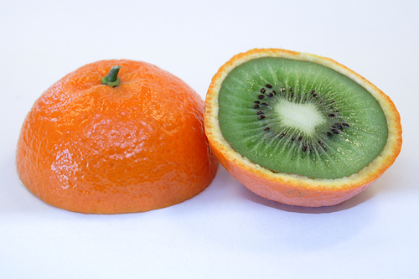
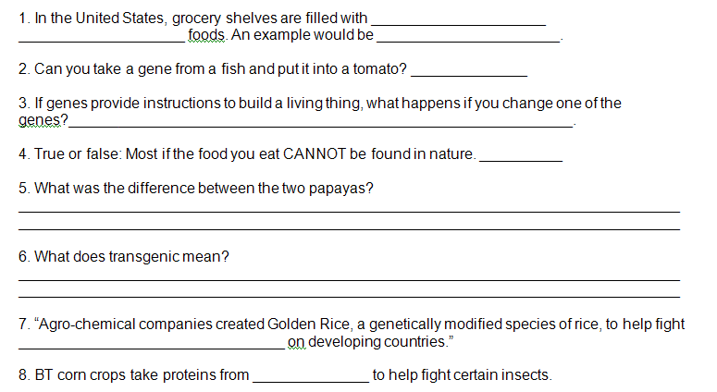
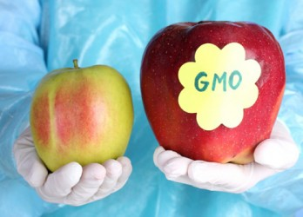
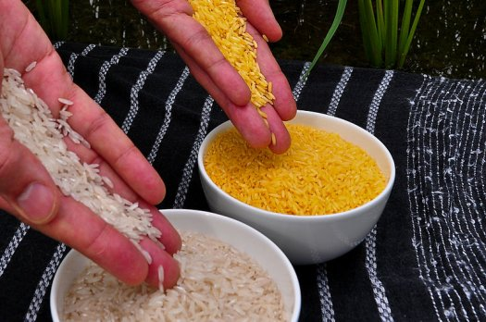
Genetically Engineered food

Slide 4
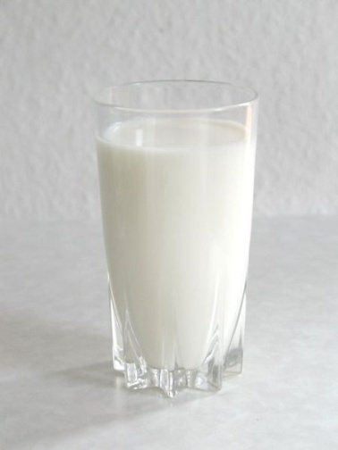
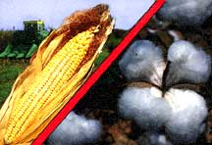
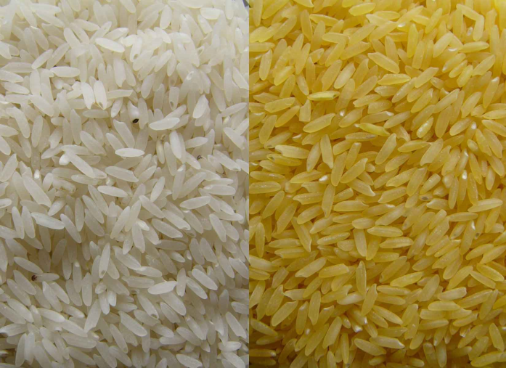
What is Genetic Engineering?
Changing the genetic make-up of an organism using techniques that remove and replace genetic material

Slide 5
Biotechnology in Microbiology
Using microbes to remove harmful toxins
Example: oil spills and sewage treatment

Slide 6
Biotechnology in Forensic Science
Forensic science-branch of science relating to crime scenes and legal fields.
blood typing and DNA analysis.
Notes:
Forensic biotechnology is the application of biotechnology to the legal system. Typically, forensic biotechnology is associated with DNA fingerprinting.

Slide 7
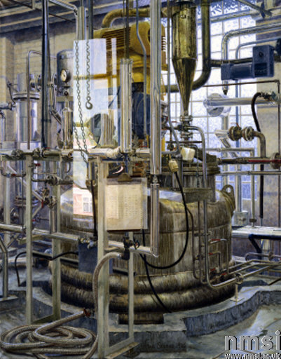
Biotechnology in Medicine
Genetic testing for diseases
Stem cells
Burn victims
Drug development
making insulin
arthritis medications
New antibiotics

Slide 8
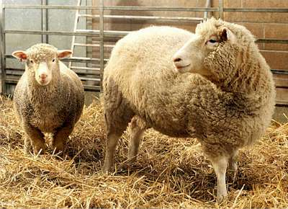
Cloning
Cloning-creation of genetically identical organisms.
New organism will have the same DNA as the original organism and will become IDENTICAL!!!
Rat, mice, camel, monkeys, pigs, dogs, horses
Cloning pets

Slide 9
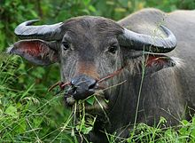
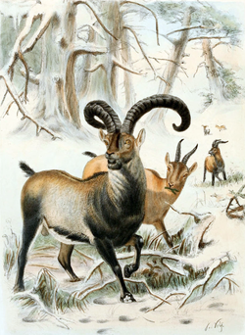
Water Buffalo: Cloned in India but died five days later due to lung infection
Pyrenean Ibex was the first extinct animal to be cloned back to life; the clone lived for seven minutes before dying of lung defects
In 2001, a cow named Bessie gave birth to a cloned Asian gaur, an endangered species, but the calf died after two days
In 2003, a banteng was successfully cloned, followed by three African wildcats from a thawed frozen embryo.
Wooly mammoths

Slide 10
Biotechnology in Agriculture
an insect resistant crop of corn.
Crops can produce more, grow quicker and longer….more $ for farmers
Animals can produce more meat, milk or wool.
Healthier crops (more vitamins)
Makes it possible to grow crops in areas that weren’t able to before (ex. Places with little water)
Pick any 2 to write down

Slide 11
Examples of genetically modified organisms

Slide 12
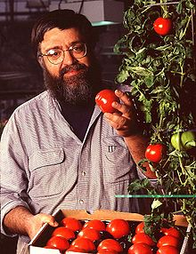
Flavr Savr Tomato
Flavr Savr tomato, a tomato engineered to have a longer shelf life
slow the ripening process of the tomato and thus prevent it from softening

Slide 13
Golden Rice
Undernourished people in poorer countries may have blindness caused by a lack of vitamin A
Contains beta-carotene, which forms Vitamin A

Slide 14
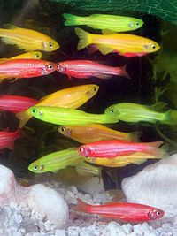
GLO FISH
The GloFish is a patented and Trademarked brand of genetically modified(GM) fluorescent fish

Slide 15
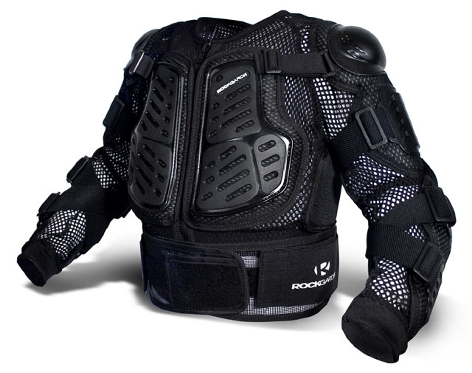
Spider Silk
Elastic, light weight fiber 5 times stronger than steel
One method involves inserting the gene from a weaving spider into a fertilized goat egg. The resultant “spider-goat” produces milk that can be manufactured into strong fibers.
Used To make flak jackets, rope, textiles, sutures, artificial tendons, and bandages for burn victims
http://www.chm.bris.ac.uk/motm/spider/goat.jpg

Slide 16
Glowing Organisms
Genes that make jellyfish glow are inserted into other organisms
The organism glows under UV light
http://www.fluorescentpets.com/prod31.jpg

Slide 17
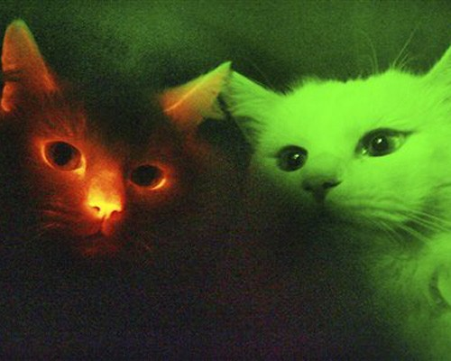
Glow in the dark cats

Slide 18
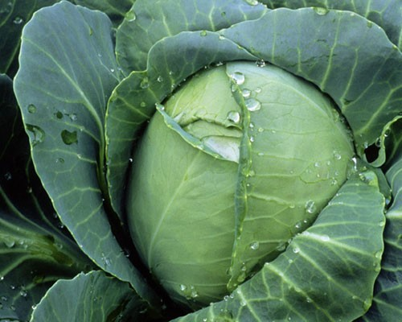
Venomous Cabbage
the gene that programs poison in scorpion tails and combines it with cabbage.
Limits pesticide by preventing caterpillars from damaging cabbage crops.
cabbages would produce scorpion poison that kills caterpillars when they bite leaves — but the toxin is modified so it isn’t harmful to humans

Slide 19
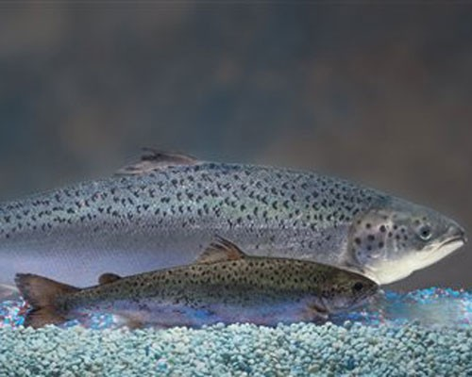
Fast Growing salmon
genetically modified salmon grows twice as fast as the conventional variety.
The company says the fish has the same flavor, texture, and color as a regular salmon
however, the debate continues over whether the fish is safe to eat.

Slide 20
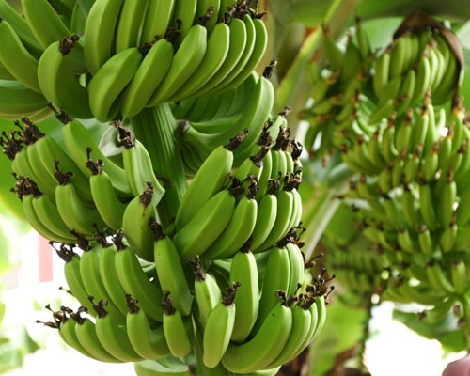
Banana Vaccinations
hepatitis B and cholera vaccinations by taking a bite of banana.
Researchers have successfully engineered bananas to produce vaccines
When an altered form of a virus is injected into a banana sapling, the virus’ genetic material quickly becomes a permanent part of the plant’s cell

Slide 21
Genetically Modified Trees
Trees are being genetically altered to grow faster, yield better wood and even detect biological attacks. Proponents of genetically engineered trees say biotechnology can help reverse deforestation while satisfying demand for wood and paper products.

Slide 22
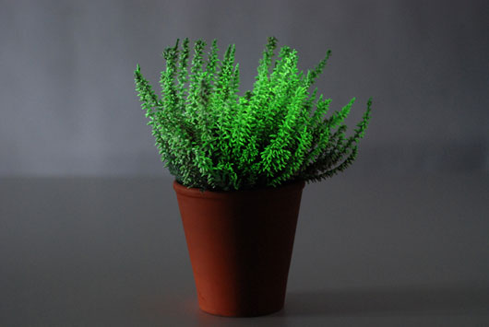
Plants
Firefly gene
incorporated into
plants
Makes “glowing”
plants

Slide 23
Ethical Issues in Biotechnology
Lot of debate about messing with “nature”.
Possibility of food allergies.
Long term effects are unknown

Slide 24
Biotechnology in NC
Research Triangle Park- Raleigh, Durham, Chapel Hill. Includes research from NCSU, Duke, and UNC.
North Carolina Research Campus- (NCRC) in Kannapolis, NC.
Both research areas of nutrition, agriculture and human health.

