Slide 1
GENETICS 101

Slide 2
GENETICS 101…55

Slide 3
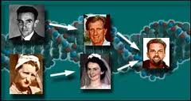
Passing of genes from parent to offspring.
Heredity

Slide 4
Asexual Reproduction
One parent
Offspring is genetically identically to the parent
No variety

Slide 5
Sexual Reproduction
Two parents!
Offspring have traits from both parents
variety in offspring

Slide 6
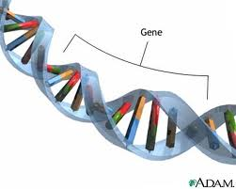
Genes
Unit of heredity

Slide 7
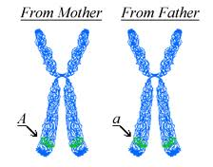
Various forms of the same gene
COME IN PAIRS!!!
Alleles

Slide 8
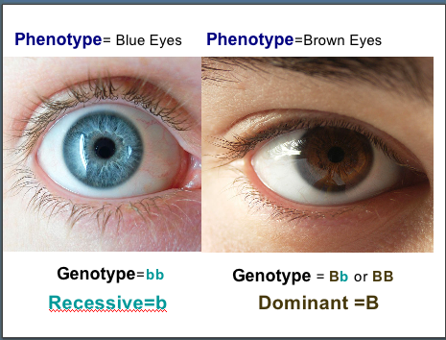
Physical characteristics
Ex. Fur color, size, thorns on leaves
Phenotype

Slide 9
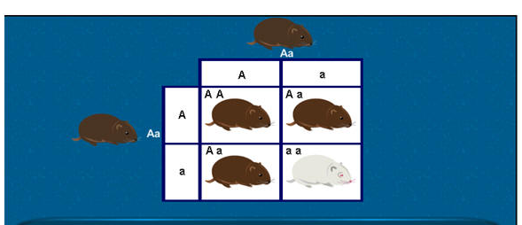
The genes
Tt, TT tt
Genotype

Slide 10
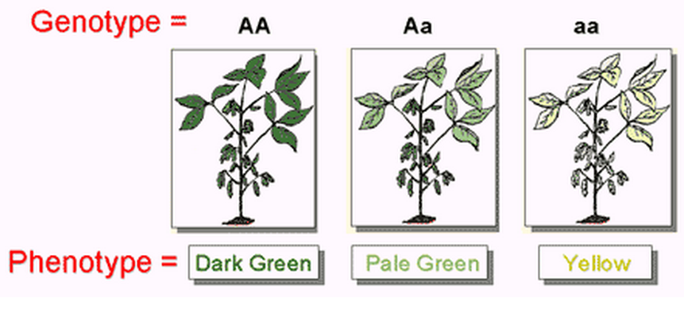

Slide 11
Dominant Allele
Stronger gene
Ex. Brown hair, freckles

Slide 12
Recessive Allele
Weaker gene
expressed when you have 2 recessive alleles
Ex. Blonde hair, no freckles

Slide 13
Homozygous
2 of the same alleles
Homozygous Dominant- 2 dominant alleles RR
Homozygous Recessive-2 recessive alleles rr

Slide 14
Heterozygous
Having 2 different alleles (Rr)
hybrid

Slide 15
Tall(T) is dominant over short(t)
TT
Tt
tt
TALL
SHORT

Slide 16
A tall plant (TT) is crossed with a short plant (tt)- TT x tt
_________ % Tall
_________ % short

Slide 17
A tall plant (Tt) is crossed with a short plant (tt)- Tt x tt
_________ % Tall
_________ % short

Slide 18
A tall plant (Tt) is crossed with another tall plant (Tt) (2 hybrids)- Tt x Tt
_________ % Tall
_________ % short

