Slide 1
Infectious Disease Vocabulary …82

Slide 2
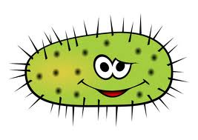
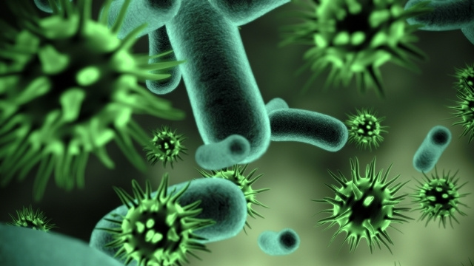
MICROBE: Any microorganism (cannot be seen with the naked eye)
Can be harmful, helpful, or neutral

Slide 3
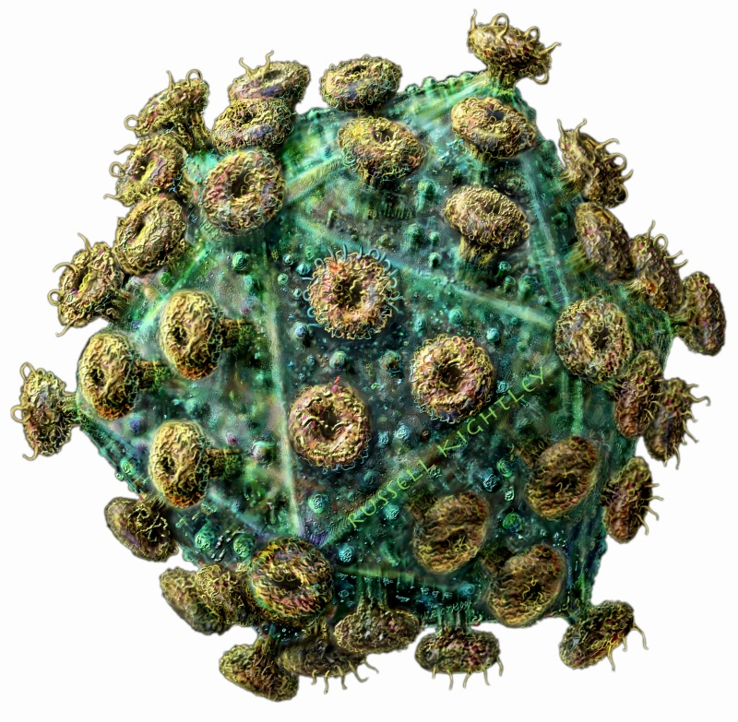
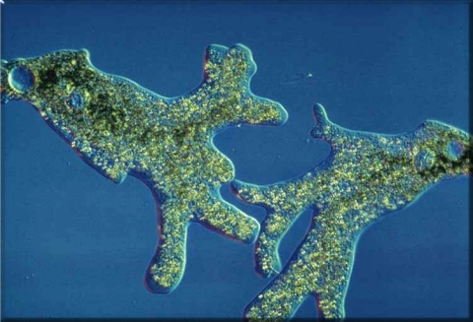
Pathogen
Any disease producing agent
Protist, bacteria, parasite, virus
Harmful

Slide 4
Non Infectious Disease
A disease not passed by organisms among people, but by genetics or life style factors
Cancer, diabetes, allergies

Slide 5
Infectious Disease
Any disease caused by the presence and activity of a pathogenic microbe
common cold, influenza
Outbreak

Slide 6
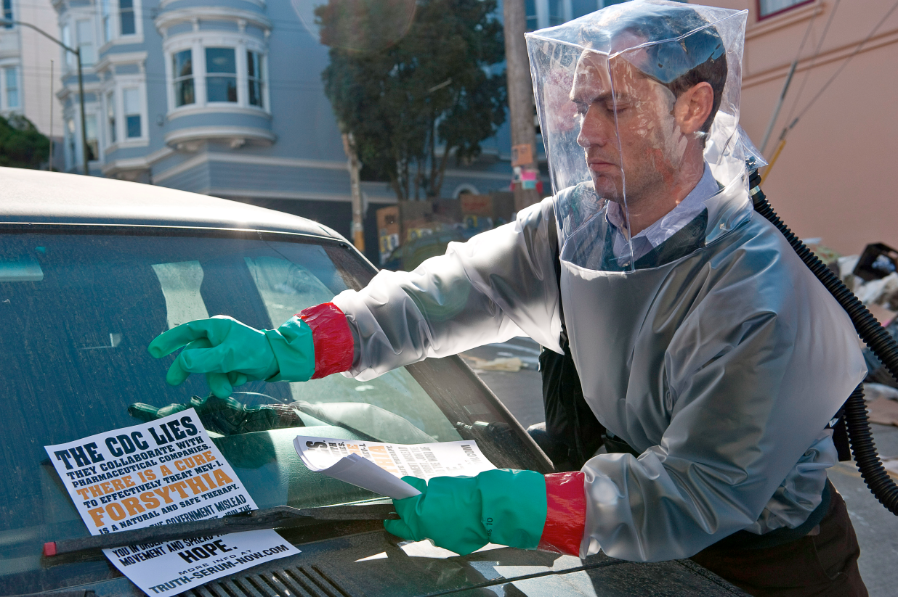
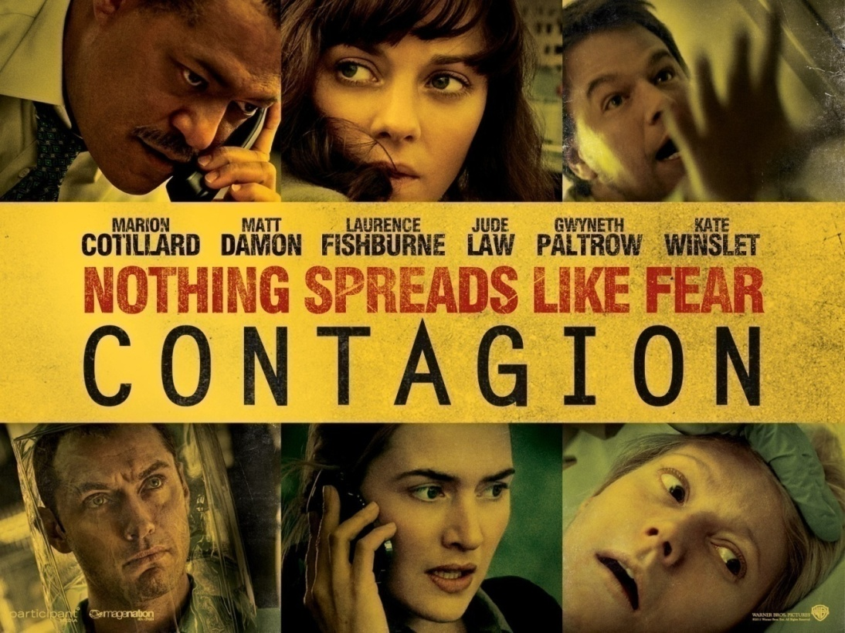
Contagion
The transmission of a disease by direct or indirect contact
Same as infectious diseases

Slide 7
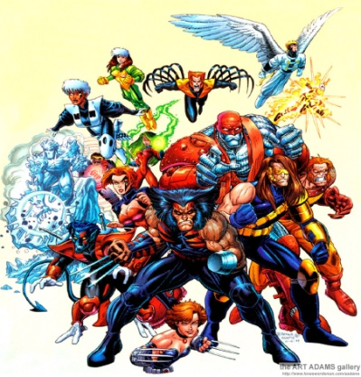
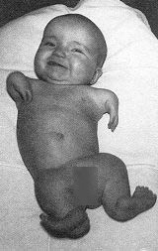
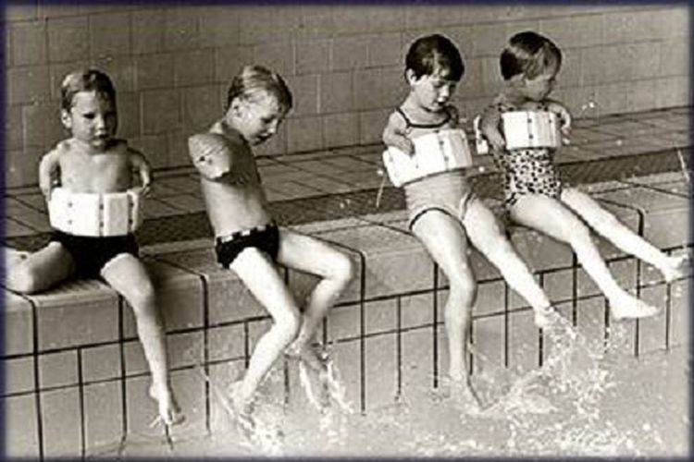
Mutagen
Anything that changes the DNA of an organism
Cancers (radiation)
Birth defects (Thalidomide)
Thalidomide

Slide 8
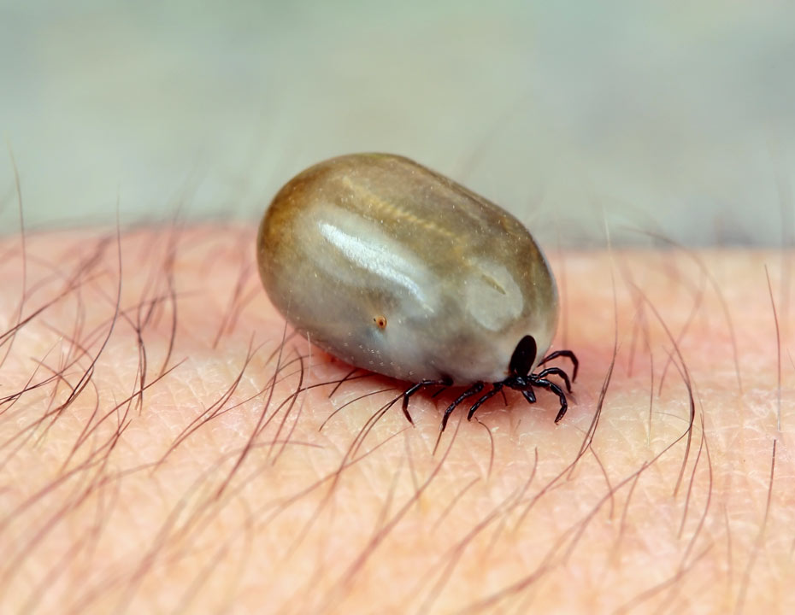
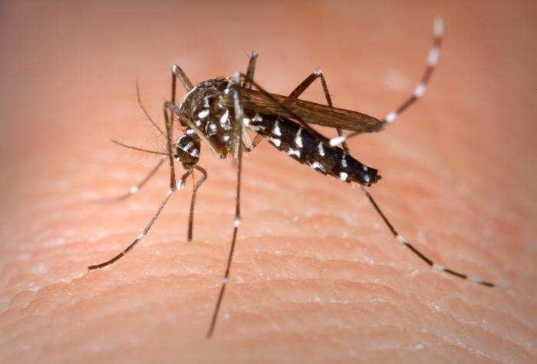
Vector
A living thing that transmits a disease from one organism to another
Ex.
Mosquito (malaria, yellow fever, west nile)
Ticks (Lyme disease)

Slide 9
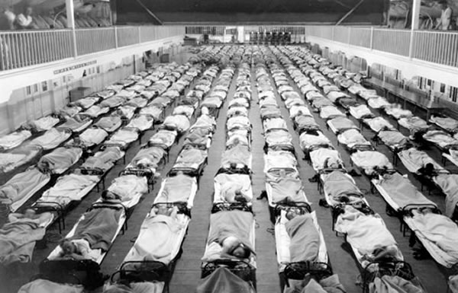
EPIDEMIC:
A rapid spread of disease, in a localized area
Ex. Ebola, SARS

Slide 10
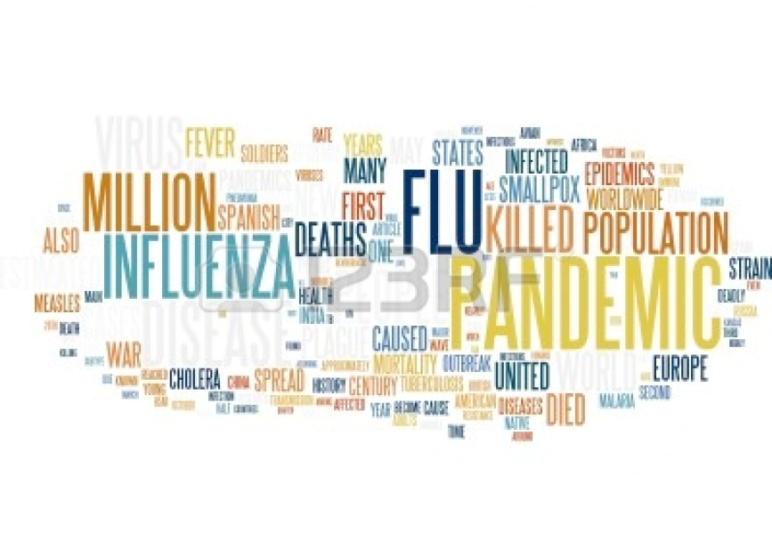
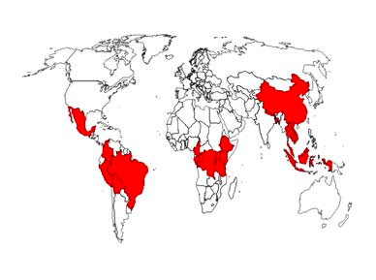
PANDEMIC:
A disease prevalent throughout an entire country, continent, or the whole world; epidemic over a large area
Crosses international borders
Ex. HIV, flu, plague

Slide 11
Vaccine
Contains a weakened form of a pathogen so that it does not cause the disease
Chicken pox, flu, measles - vaccinations

Slide 12
Antimicrobial Product
A substance designed to kill microbes before they can enter your body
Hand sanitizer

Slide 13
Antibiotic resistance
when bacteria develop a tolerance to drugs that once killed them

