Slide 1
Metals, Nonmetals, Metalloids

Slide 2
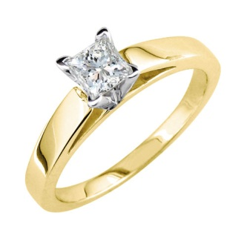
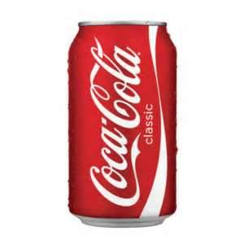
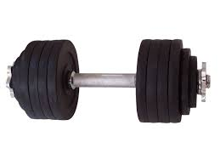
METAL
Metals are elements that conduct electricity and heat
Malleable-can be flattened
Ductile- can be made into a wire
Shiny
High melting point
Magnetic
High density
Iron
Aluminum
Gold

Slide 3
NONMETALS
An element that usually has properties opposite of metal
gas
Easily broken
Dull
Poor conductor of heat and electricity
Neon
Helium
Oxygen

Slide 4
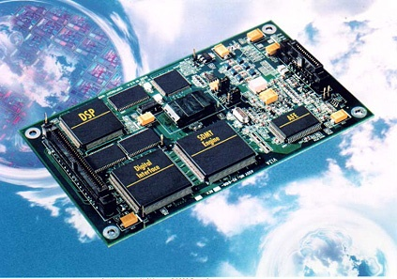
METALLOID
Properties of metals and non metals
Found on zig zag line of the periodic table
Semi conductors
Arsenic
Silicon

