Slide 1
Radioactive Decay…47
Used to find the absolute age
The rate of decay is measured in half-lives.
A half-life is the amount of time it takes for half of the atoms to change into another form.

Slide 2
2 Common Methods
Carbon -14
Half Life: 5730 years
Good for: Determining the age of the “younger” fossils
Note:
dating objects up to 60,000 years old
Only works on things that were once alive (not rocks)
Decays rapidly
Uranium-238
Half Life: 4.468 billion years
Good for: Determining the age of the “older” fossils
Note:
up to 4 billion years
Decays slowly

Slide 3
Parent material
Daughter Material
50 %
75 %
87.5 %
93.75%
100 %
1st half life
2nd half life
50 %
3rd half life
25 %
4th half life
12.5 %
6.25 %

Slide 4
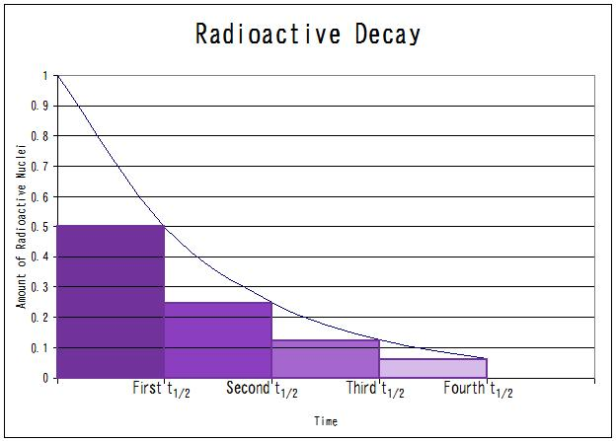
Carbon-14 has a half life of 5730 years
If you find a fossil that has been through 3 half lives, how old is it?
(5730 x 3 = 17,190)

Slide 5
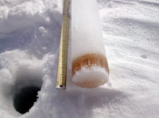
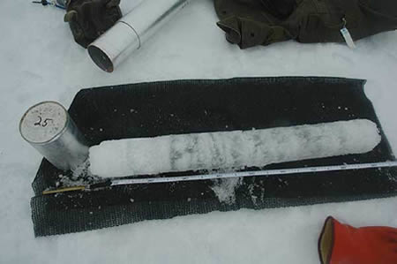
ICE CORE
Ice forms layers similar to that of rock
Follows law of superposition
Provides information about climate (thickness of ice layers)
Analysis of the ice tells about the atmosphere (CO2, oxygen, volcanic ash)
An ice core from Antarctica 3km long showed 740,000 years of history and 8 ice ages!!!

